Slide 1

Quick Launch English
Overview

Slide 2

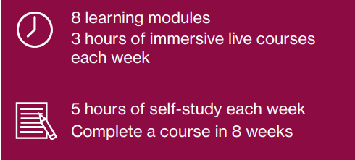

What is Quick Launch?
English up-skilling across a variety of goals (e.g., university classroom, career, and more)
Learners participate in a mix of live, active learning and self-paced independent study
Live classes emphasize communicative practice
Short-term study with reduced time commitment
Certificates earned upon completion

Slide 3
Quick Launch
Session Calendar
Fall A 2023 | Fall B 2023 | Spring A 2024 | Spring B 2024 | Summer 2024
August 17 – October 3 | October 12 – December 1 | January 9 – February 23 | March 11 – April 26 | May 16 – July 3
Weekly schedule Monday, Wednesday, Friday
8 to 8:50 AM Arizona time
Look for updates to times.

Slide 4
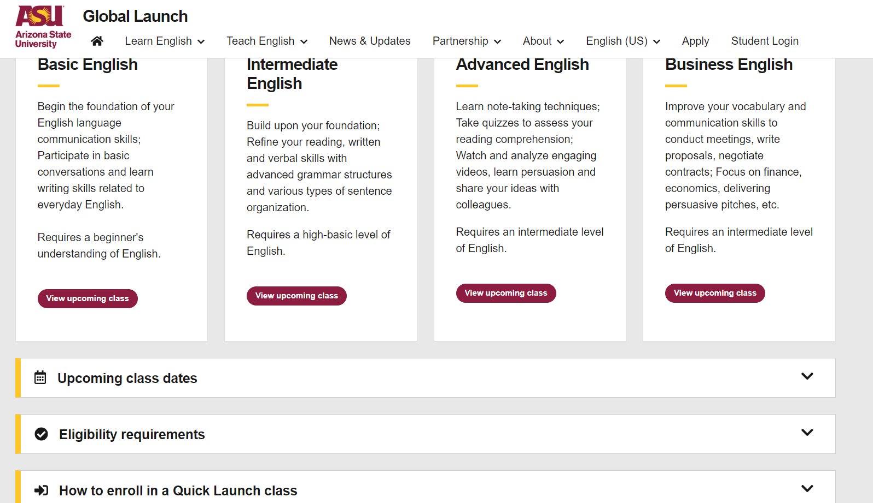
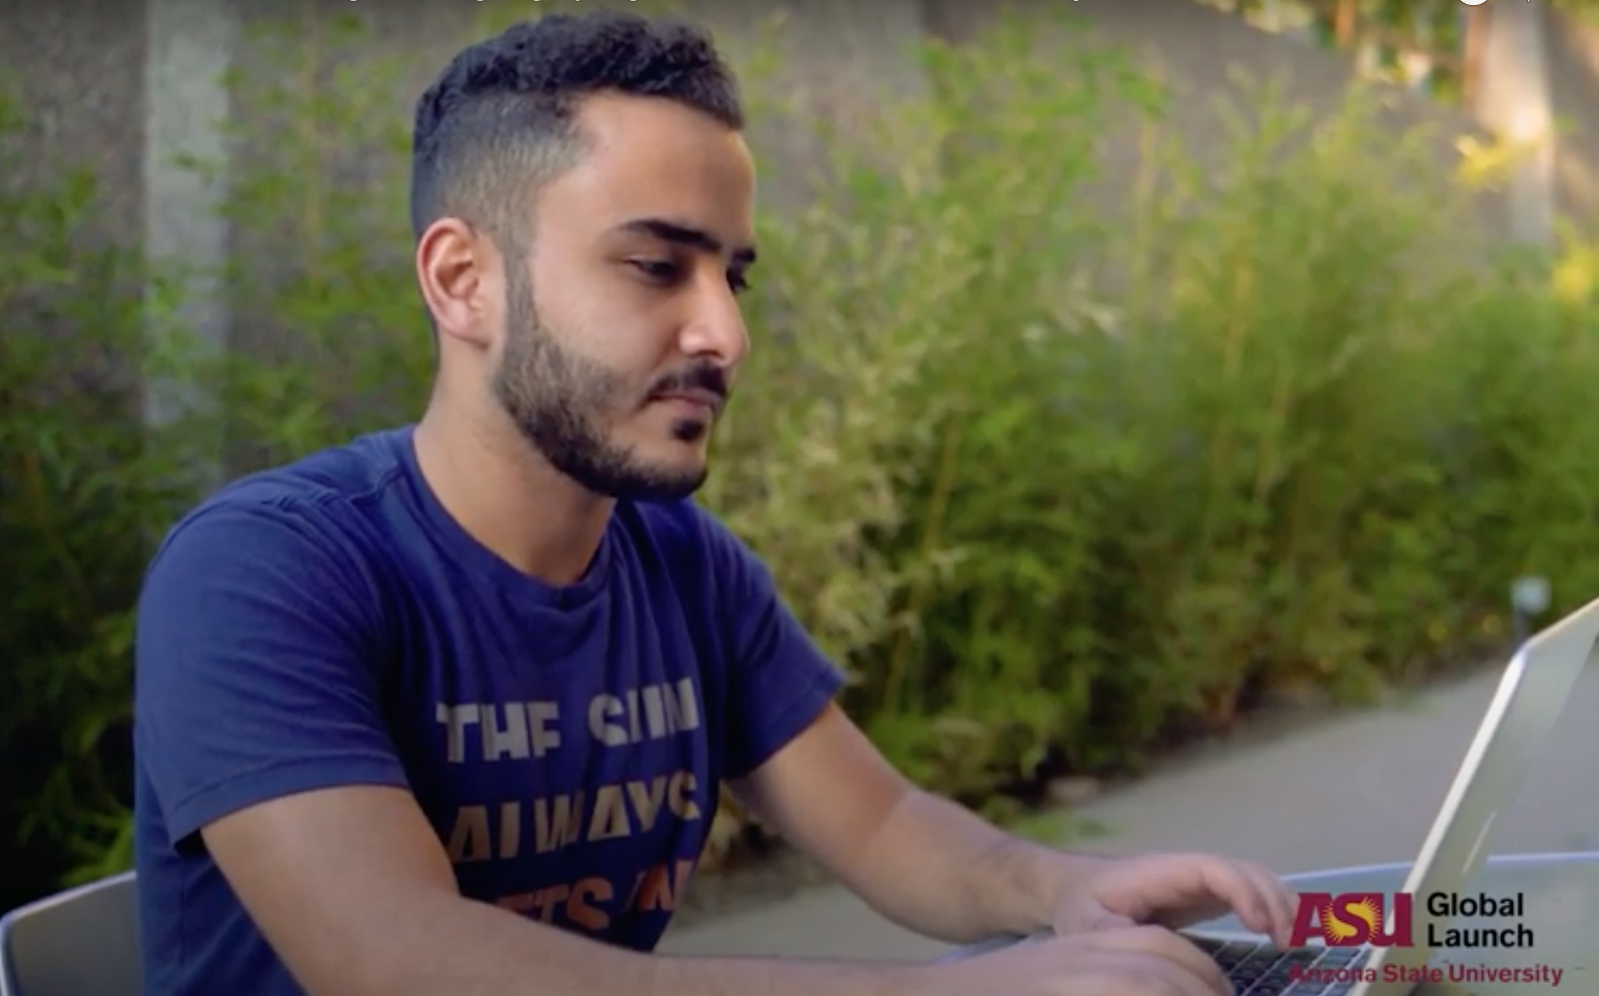
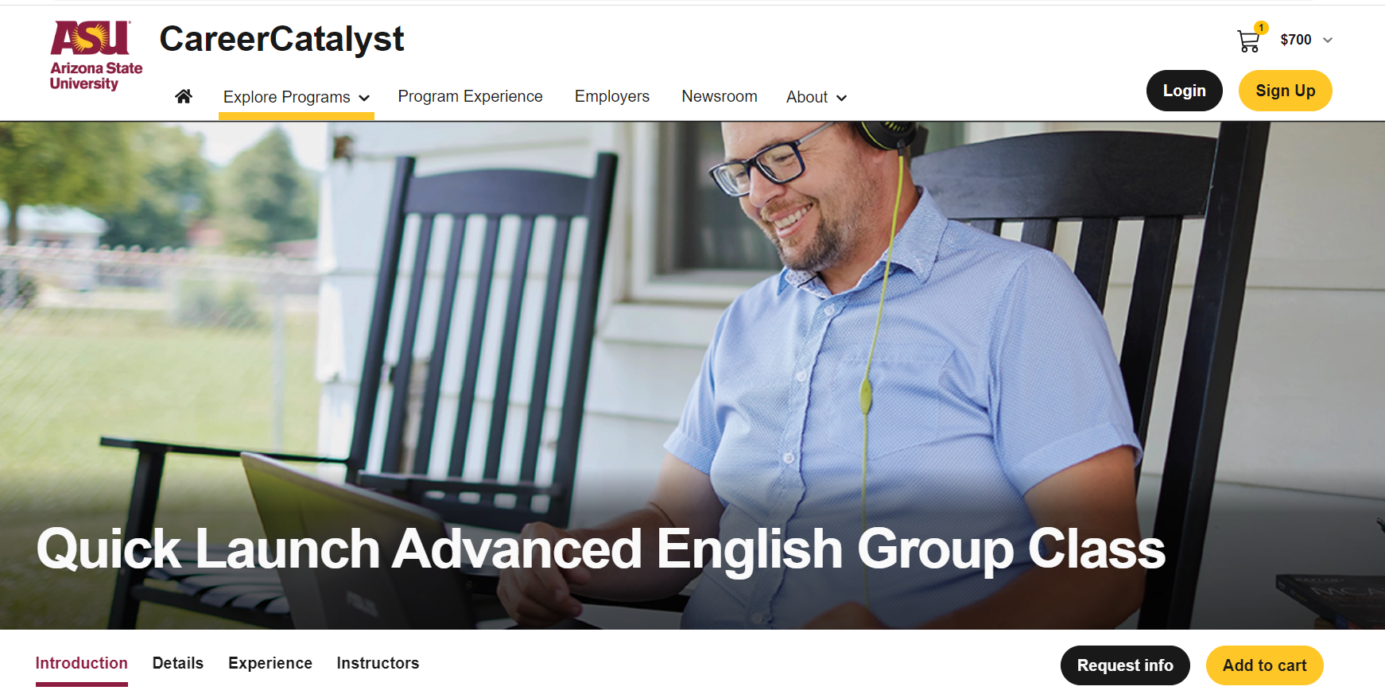
Quick Launch
Registration
Visit Quick Launch page.
Take free online placement test
Participants choose their level
Navigate from Quick Launch page to Career Catalyst (link embedded on page)
Choose course
Add to cart; view cart; pay

Slide 5



Contact us
+1 (480)-965-2376
Shoshanna.Starzynski@asu.edu
Visit virtual Welcome Desk at https://asu.zoom.us/j/632920306
Visit in person, at Creative Commons, 3rd Floor, left of elevator bank

